Slide 1
METS 2 RDF
Working group progress report
iPRES – November 2nd 2015

Slide 2



Working group objective
Working on an RDF expression of METS starting from existing METS Editorial Board work, use cases and the BnF experience
Notes:
Our objective was to work on an RDF expression of METS starting from existing MEB work (mainly Thomas Habing’s proposal presented on September 2014), use cases and BnF experience.
We needed practical examples to see how the whole data model would work.

Slide 3
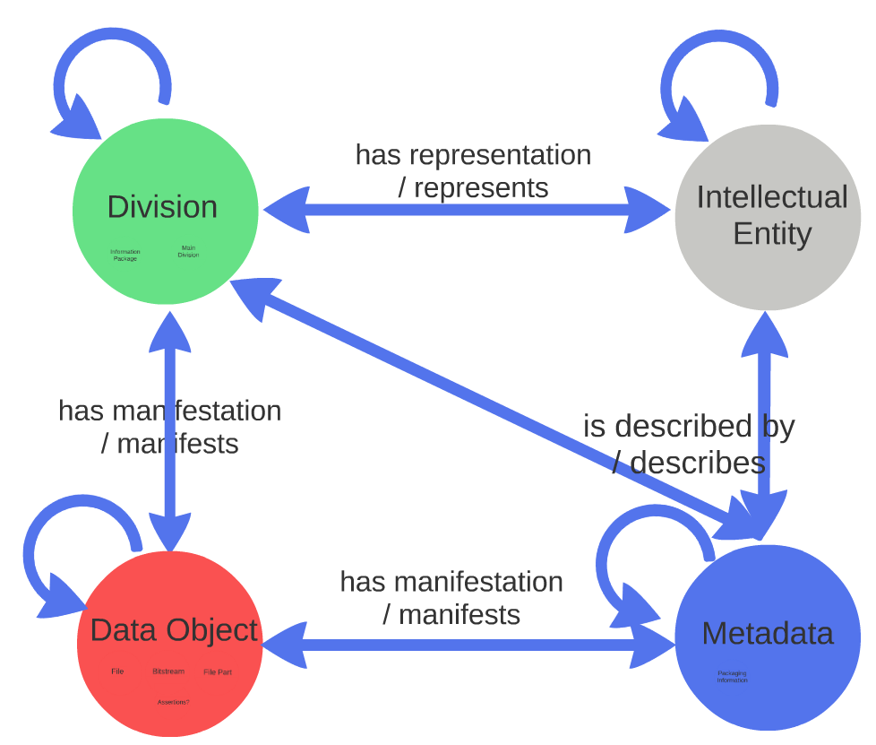
Different proposals for a Data Model
September 2014
November 2015
Notes:
Same as PREMIS: conceptually, this way of thinking is extremely interesting.
the data model sketched by Thomas Habing was quite satisfactory but not all issues were addressed;
Working on how to express METS in RDF led us to think on which classes and properties could be taken directly from METS 1, which ones are not useful in RDF, and which ones could be taken from existing ontologies.

Slide 4
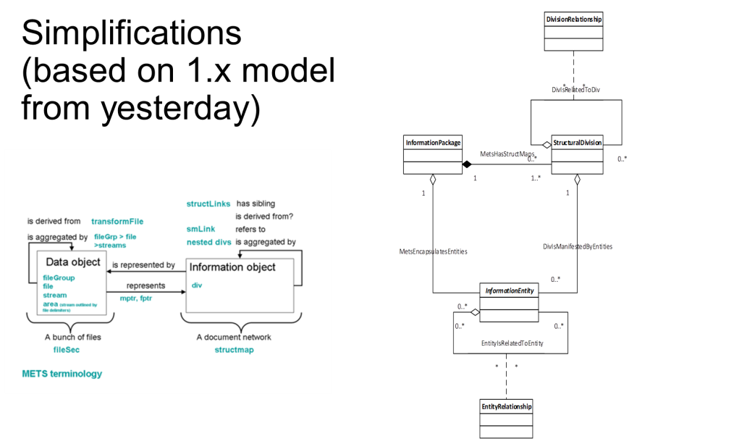
Some other issues…
Source metadata?
Collections?
Intellectual entities?
File group?
Notes:
the data model sketched by Thomas Habing was quite satisfactory but not all issues were addressed;

Slide 5


Put another way…
Notes:
METS 2 RDF leads to a discussion on the Data Model and to "METS Lite"!
To the question "Is METS good enough as it is?", METS 2 RDF’s answer would probably be a "no"…

Slide 6



METS 2 perimeter
Object Reuse and Exchange
Open Annotation
Notes:
But also: XFDU, SEDA, FOXML, etc.
consequently, a choice between creating a whole new ontology independent from others and re-using some elements from existing properties has to be made case-by-case.
Aligning METS notions is also a way to make explicit them.

Slide 7
METS 2 perimeter (cont’d)
Like METS 1…
Describing complex as well as simple digital objects
Allowing different views for the same digital object
Linking components to all sorts of metadata
But could also be…
Being able to describe links to higher levels of structure than the Information Package
Handing down technical and digital provenance metadata to PREMIS

Slide 8
METS 2 RDF main goals
Improving coherency
Maintaining functionalities
Enriching expressivity
Aligning and re-using ontologies
Enhancing interoperability
Reducing verbosity
Notes:
Improve the coherency by making explicit the data model
Describe as many digital documents as METS 1 was doing (digitized books and periodicals, audiovisual, web data, etc.)
Enhance expressivity (introducing Intellectual Entities, handling metadata as data objects)
Align the data model notions with other standards to re-use existing ontologies
Improve interoperability by making explicit XML peculiarities, mainly aggregation and order (this is more a consequence of #1)
Reduce verbosity addressing simple use cases and more complex ones similarly

Slide 9
Verbosity
Should be avoided when possible, but seems quite necessary to express complex structures - like 3D objects.
  “The number of RDF triples required or bytes needed for serializations, while a consideration, is less important than the coherency of the model.”
  Open Annotation Data Model
Notes:
In the BnF DR, named graphs (defined as all triples generated by the RDF exposition of an AIP) reduces the queries complexity (no need to browse the whole graph to get the information wanted)

Slide 10
METS to RDF in SPAR, the BnF Digital Repository
SPAR = Scalable Preservation and Archiving Repository

Slide 11
Context
SPAR ontologies created around 2008 to express the METS files content in RDF (SPAR’s modules interactions are entirely based on RDF)
At this time, there was no PREMIS ontology…
The BnF created several ontologies, based on different types of information according to OAIS: reference, provenance, representation, fixity, context and structure (METS scope)
Presenting SPAR ontologies is meant to be a starting point… but not necessarily an example to be followed!

Slide 12


Data and Metadata
P
r
e
-
i
n
g
e
s
t
Ingest
Preservation
Planning
Administration
Access
RDF
Data Management
RDF
SIP
METS
METS
Storage
AIP
AIP
Storage Abstraction Service
AIP
METS
Notes:
Architecture: one module = one OAIS entity
Entirely automated.

Slide 13




METS sections used in BnF’s Scalable Preservation and Archiving Repository (SPAR)
<mets>
<metsHdr>
METS file information
<sourceMD>
Original document
<dmdSec>
Descriptive metadata
<techMD>
Technical metadata
<amdSec>
Administrative metadata
MPEG-7
<fileSec>
Files list
<digiprovMD>
Provenance metadata
<structMap>
Package structure
Notes:
dmdSec : utilisation de Dublin Core
sourceMD : utilisation de Dublin Core
techMD, informations techniques de bases sur les fichiers et le paquet dans son ensemble : PREMIS:object
techMD, informations techniques poussées sur les fichiers : MIX (images), textMD (texte), MPEG-7 (son et vidéo)
PREMIS:event : digiprovMD

Slide 14






Information granularity: 4 main levels
AIC (Archival Information Collection) level
Set of
documents
periodical
<div TYPE="set">
Multivolume monograph
Discrete digital
document
periodical issue
AIP (Archival Information Package) level
<div TYPE=« group">
Physical unit
Part of a
digital document
<div TYPE=« object">
Side
Track
Page
Data Object
<file>
File

Slide 15
SPAR Structure Ontology
sparstructure:set
oai-ore:isAggregatedBy
sparstructure:group
sparstructure:structuralMap
oai-ore:aggregates
sparstructure:object
oai-ore:isAggregatedBy
sparstructure:fileGroup
oai-ore:aggregates
sparstructure:file
oai-ore:isAggregatedBy
Notes:
At the beginning, there was no file group, but it was created to put in common techMD.

Slide 16
SPAR ARK policy
sparstructure:set
rdf:type
<ark:/12148/bc6p03wjs>
sparstructure:group
oai-ore:isAggregatedBy
rdf:type
<ark:/12148/bpt6k208207v>
sparstructure:
structuralMap
sparstructure:object
oai-ore:aggregates
oai-ore:isAggregatedBy
rdf:type
rdf:type
<ark:/12148/bpt6k208207v/physical3>
<ark:/12148/bpt6k208207v.physical
sparstructure:file
sparstructure:
fileGroup
oai-ore:aggregates
oai-ore:isAggregatedBy
rdf:type
rdf:type
<ark:/12148/bpt6k208207v/physical3.master>
<ark:/12148/bpt6k208207v/master>
Notes:
Qualifiers of ARK identifiers were used to isolate parts of the Information Package.
ARK is considered internally as an URI schema though not registered as so by IANA.

Slide 17
Data Model: what issues arose?

Slide 18
What entities do we consider to be in the METS scope?
Divisions
  Information Package
  Structural Map?
Metadata
  Packaging information
Intellectual entities?
Data objects
    File
    Bitstream
    Assertions?
File Group?
File part?
Sequence/Parallel/Alternative?

Slide 19
How could the Data Model look like?
Note that classes and properties proposed in the next slides, and their creation in METS ontology or re-use from existing one is still subject to discussion
Notes:
Or use the named graph mechanism to represent the IP?
The IE introduction is one of the main innovation compared to the DM presented in September 2014.
Divisions: any grouping of contextualized resources (other Divisions or Data Objects), specific to the Information Package the METS document is describing.
Data Objects: Files, Bitstreams, File Parts
Intellectual entity: logical content of a Division

Slide 20
Information Package
The RDF version of METS XML file
Is described by / describes
Information package
Packaging information
Notes:
Users could use the named graph mechanism to represent the IP

Slide 21
Structural Map
rdfs:member
subclass of
subproperty of
Information package
rdf:Alt
has part
subproperty of
has structural map
Alternative structural maps
Division
Division
Notes:
METS allowed different views of an Information Package – this METS 1 feature should be preserved.
In our proposal, the Structural Map would be a subclass of a division, and would be aggregated by the Information Package
But do we still need such a class? Or the expression of an alternative view thanks to a property could be sufficient?
If users don’t need alternative structural maps, could they directly link to the components of the IP by a "has part" property?
"Physical" structMap can be understood only if we think about the physical organization of an analogic document.
Or an Alternative expressed by a special class or by a property? Ex.: hasStructuralMap = subproperty of aggregates?
In fact, I would speak up for preserving this notion in METS…

Slide 22
Divisions
Division
has part / refers to / has source / ?
Alternative
Information
Package
Structural
map
Sequence
Parallel
Notes:
What properties linking divisions? Not only "aggregates" but also "refers" to solve the structLink use case, and others?
Divisions are structural (tangible) parts of a digital object stored in a DR
Thus, they describe an Information Package structure, not necessarily the Object intellectual structure
Bound together by relationship properties: which ones should be defined?

Slide 23
Divisions (continued)
Should Divisions be specialized with equivalent to RDF Container subclasses?
rdf:Container
rdf:subclassOf
rdf:Alt
rdf:Bag
rdf:Seq
Notes:
Nice… But the container nature could vary over time, e.g., if an additional representation is added, a Division could become an Alternative…

Slide 24
Data Objects
Data Objects
Assertions?
File
Group
File Part
premis:
Bitstream
File
premis:File
Stream

Slide 25
File Group
<fileGrp USE="TIFF">
<fileGrp USE="master">
A technical artifact to link files to their technical metadata?
A specific view of the Information Package?
File Group
subclass of
subclass of
Or…
Data Object
Division
Notes:
Is the File Section a specific view of the package? Or just a means to link many files to their technical metadata?
When it is used to group heterogeneous files, what is the benefit? Can’t it be another structural map (but in this case, we need to allow techMD to be linked to divisions, and this could be a problem when aligning the DM to PREMIS).
BnF uses it as a way to put in common technical MD (file groups are homogeneous), but not everyone uses it this way.
File groups are a way to group files according to a production logic: generally, service providers deliver a file group…
File Section and File Groups as subclasses of division? This means the PREMIS alignment cannot be done at the Division level, but at its subclasses level.
Is File Group a subclass of Division, of Data Object or even of Metadata?? If the fileGrp only aims to gather metadata on files, considering it as a Division is not really relevant.
Another use of the file group: it bears the USE attribute, so that when a Division has two alternative manifestations, the USE attribute of each one distinguishes each one (this is how it is done in SPAR).
This issue was not mentioned in Thomas Habing’s presentation.
Both solutions, depending what implementation choices were made, are true.
USE="master«
Example of PAIS: transferObjects, tranferObjectGroups…

Slide 26
File Group (continued)
  “A link between a <fileGrp> element and an <amdSec> does not associate the aggregation represented by the <fileGrp> with the administrative metadata, but the individual aggregated resources with the administrative metadata.”
  J. McDonough, "Aligning METS with the OAI-ORE data model“
File
File
File
Format
Color depth
Resolution
Format
Color depth
Resolution
Format
Color depth
Resolution
File
File
File
VS
File Group
Format
Color depth
Resolution
Notes:
It seems that users still need a "file catalog" – partly because file groups can put in common technical MD about files.

Slide 27
Intellectual Entity
The logical content…
… of a specific Division (physical or digital items that represent it).
has representation / represents
Intellectual entity
Division
Notes:
Tom’s example of a postcard: two divs, one with two fptr or three divs?
Tension between describing an IP organization and an intellectual structure!
Useful for non-library users? Anyway, using the IE is not mandatory.
But in the case divs integrate the seq/par mechanism, using IE seems more justified.
E.g.: intellectual property linked to a work and usage vs restrictions linked to its digital reproduction.

Slide 28
Intellectual Entity
Why creating this notion in METS?
Question: What is a structural map in a METS document describing?
A specific information package structure?
The IP logical content structure?
Answer: METS has been used for both uses.

Slide 29
Intellectual Entity
Why creating this notion in METS?
1) For the purpose of aligment
PREMIS
PREMIS
FRBR
FRBR
Intellectual entity
has representation / represents
Representation
Work / Expression / Manifestation
Division
Item

Slide 30
Intellectual Entity
Why creating this notion in METS?
2) To enhance expressivity
has creation event
In SPAR today…
dc:date
dc:date
"2010"
Event
Information package
"1925"
With Intellectual Entity…
dc:rights
Is described by
represents
Is described by
dc:rights
"Public domain"
Wrapped metadata
Information package
Packaging information
"restricted use"
Volume
Notes:
To avoid confusion between an intellectual object and the physical or digital items that represent it (date, rights, etc.)
to connect a digital item to an FRBR manifestation (cf. "source metadata" slide)

Slide 31
Intellectual Entity
Why creating this notion in METS?
3) To describe higher levels than the IP
Multi-
volume monograph
has representation / represents
Information collection
?
?
has representation / represents
Information package
Volume
Notes:
to describe collections (= intellectual grouping of Information Packages)
As METS Divisions should describe an IP, IEs could be used to describe specific collections (arbitrary groupings for technical reasons, for example).
This question was not mentioned in Tom’s presentation in September 2014.

Slide 32
Intellectual Entity
Why creating this notion in METS?
4) To identify access points to intellectual content
has representation / represents
Chapter
Division
has part
Sequence
Notes:
to identify access points to intellectual content, as the Divisions are groupings of contextualized resources

Slide 33
Intellectual Entity
Why creating this notion in METS?
5) to put in common descriptive metadata between different versions of a digital object
Version 1
Chapter
has representation / represents
Version 2
Notes:
to identify access points to intellectual content, as the Divisions are groupings of contextualized resources

Slide 34
Technical and Provenance Metadata
Aren’t they in the PREMIS scope now: PREMIS Object Characteristics and PREMIS Events?
mets:
File
subclass of
premis:File
premis:hasObjectCharacteristics
premis:
Object
Characteristics
Notes:
But where will be the extension points (must the DM cover also the XML serialization?)
But if so, we cannot say anything about techMD (example: md produced by a Producer vs md produced by the Archive)
Problem: people using METS and not PREMIS ask for METS schema evolutions in order to express technical MD in METS. E. g., E-ARK
As METS 1 was doing, METS 2 should allow users to state metadata about metadata!

Slide 35
Descriptive & Rights Metadata: metadata reference
= METS 1 <mdRef>
Metadata record in catalog
Is described by
represents
Intellectual entity
Division

Slide 36
Descriptive & Rights Metadata: metadata as a Data Object
= metadata stored in a file contained in the IP
"TEI"
MD type
Metadata in file
Is described by
Volume
has manifestation
File
Notes:
Example: the table of contents at BnF
Novelty…

Slide 37
Descriptive & Rights Metadata: metadata wrapping
= METS 1 <mdWrap>
"DC"
MD type
Wrapped Metadata
Is described by
Volume
has manifestation
"Alice’s Adventures in Wonderland"
dc:title
Assertions
Notes:
Problem: OAIS distinction Data Object / Information
Where to link the properties: to the metadata class or to the assertions class?
Where to link properties (dc:right) that concern metadata??
No novelty here: METS 1 was that expressive, being able to express metadata about metadata!

Slide 38
Source metadata
= links between divisions
frbr:
manifestation
frbr:item
"text: unmediated"
"DC"
MD type
subclass of
subclass of
dc:type
"Alice’s Adventures in Wonderland"
Assertions
Metadata
Volume
Division
dc:title
has manifestation
Is described by
represents
has source
"Alice’s Adventures in Wonderland"
Assertions
Metadata
Volume
Information package
dc:type
"text: electronic"
Notes:
Being able to link the Digital Object to the catalog: this allows complete alignment to the FRBR model (today’s projects of disseminating metadata link the conceptual level to the DO level).
=> Problem with "Manifestation": it is already an FRBR term…

Slide 39
Alternative
In METS 1, an alternative exists
When there is more than one structural map
When a Division contains more than one file pointer
When a File contains more than one File Location
When a Division contains Divisions and a fptr?
Notes:
Though Seq and Par seem to be classes, Alternative could preferably be a property.
More than one Flocat = PREMIS scope (storage)

Slide 40
From Division to Data Objects
How to keep, simplify and make explicit the multiple METS 1 possibilities?
One div with one fptr
One div with several fptr (alternative versions of the same div) linked to one file each
One div with one fptr and seq and/or par
One div with several fptr, seq and par
One div with one fptr linked to one file but… with several FLocat
Notes:
RDF vocabulary includes Seq, Bag and Alt: could we use this?

Slide 41
From Division to Data Objects
One div with one fptr
Division
has manifestation
File
Notes:
Parallel, Sequence and Ordered Object are subclasses of Divisions.
But don’t we need an intermediary level between Parallel and Dos (to be consistent with the Sequence modelling and to be able to state a label property)?
Advantage: the DM is clarified as th

Slide 42
From Division to Data Objects
2. One div with several fptr (alternative versions of the same div) linked to one file each
Division
has manifestation
File
File
Notes:
Parallel, Sequence and Ordered Object are subclasses of Divisions.
But don’t we need an intermediary level between Parallel and Dos (to be consistent with the Sequence modelling and to be able to state a label property)?
Advantage: the DM is clarified as th

Slide 43
From Division to Data Objects
3. One div with one fptr and seq and/or par
Sequence
Parallel
has part
order
label
Division
Division
"2"
Division
Division
"mesh"
has manifestation
has manifestation
File
File
File
File
Notes:
Parallel, Sequence and Ordered Object are subclasses of Divisions.
But don’t we need an intermediary level between Parallel and Dos (to be consistent with the Sequence modelling and to be able to state a label property)?
YES because each element can be labelled (ex. of the Globes), for coherency and because… a manifestation is implicitly alternative (a div having a manifestations means that it is entirely represented by a DO).
Advantage: the DM is clarified as the means for grouping DOs are all in the Division scope.

Slide 44
From Division to Data Objects
4. One div with several fptr, seq and par
Alternative
has part
Sequence
Parallel
has part
has part
Division
Division
Division
Division
has manifestation
has manifestation
File
File
File
File
Notes:
Parallel, Sequence and Ordered Object are subclasses of Divisions.
But don’t we need an intermediary level between Parallel and Dos (to be consistent with the Sequence modelling and to be able to state a label property)?
Advantage: the DM is clarified as th

Slide 45
From Division to Data Objects
5. One div with one fptr linked to one file but… with several Flocat
Out of the METS scope?
premis:File
premis:hasObjectCharacteristics
premis:
Object
Characteristics
premis:hasStorage
Storage location
Notes:
Parallel, Sequence and Ordered Object are subclasses of Divisions.
But don’t we need an intermediary level between Parallel and Dos (to be consistent with the Sequence modelling and to be able to state a label property)?
Advantage: the DM is clarified as th

Slide 46
Ordering and labelling Data Objects
How to express the Divisions / Data Objects order?
METS property "order" linked to a literal;
RDF Seq / RDF List;
OAI-ORE Proxy;
Or PREMIS relatedObjectSequence?
Notes:
Rdf:Seq is more flexible thant rdf:List. The latter implies that the list is closed and that there are a first and a last element.
A Division is very close to an ore:proxy: in both cases, we express information about an aggregation context.

Slide 47
The Named Graph
could be used to
identify all the triples of an Information Package, reducing queries complexity (current use in SPAR);
reify a set of metadata triples (instead of a "Metadata" class).
But…
the named graph mechanism is still not a stable W3C specification;
a named graph should not be an equivalent to a class…
Notes:
The named graph is a way to represent the Information package extent in RDF.

Slide 48
Examples – at last!

Slide 49
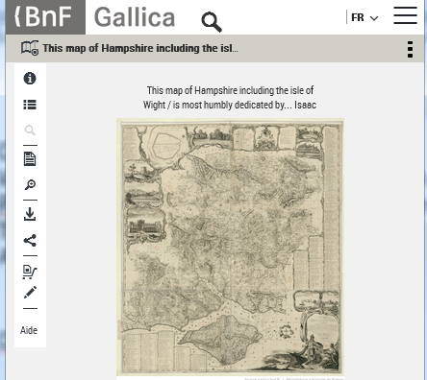
Still image
Most simple example
One Data Object => no alternative

Slide 50
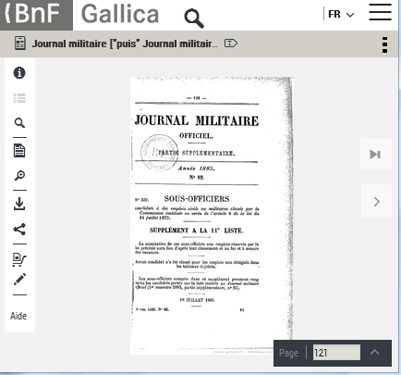
Periodical issue
A higher level (periodical) above the IP (issue)
A physical and a logical structMap
One master file and one ocr file for each page
Page level descriptive metadata
File Parts identification using Open Annotation

Slide 51
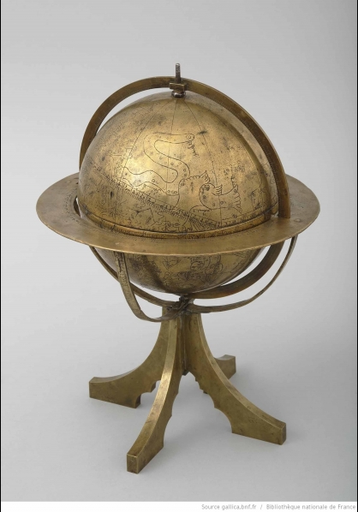
3D digitized globe
Two structural maps: one for the 3D digitization, the other for the 2D digitization
An alternative between high and medium resolution versions
High-res |  | Medium-res
Mesh | Texture | Mesh | Texture
1 x3d | 6 tiff | 1 obj 1 mtl | 2 jpg

